Slide 1

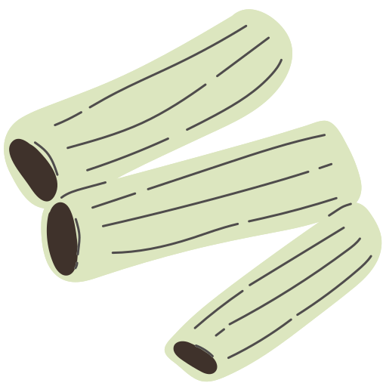
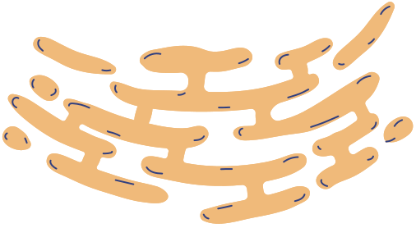
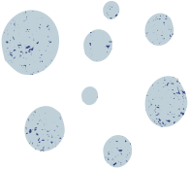

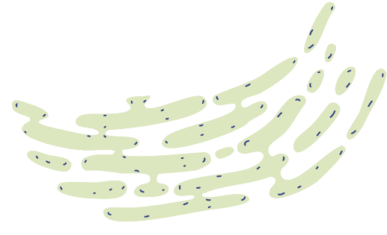
Phylum Spirochaetes
Microbiology

Slide 2
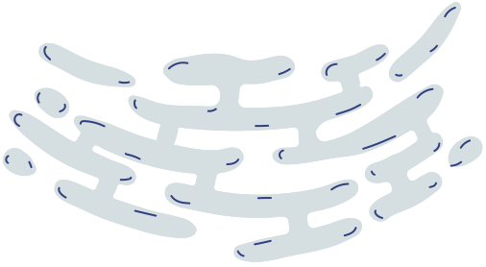

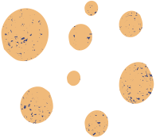
Definition and Classification
Phylum Spirochaetes includes gram-negative, chemoheterotrophic bacteria.
It is classified into one class (Spirochaetes), one order (Spirochaetales), and three families (Spirochaetaceae, Serpulinaceae, Leptospiraceae).
There are currently 13 genera within this phylum.

Slide 3
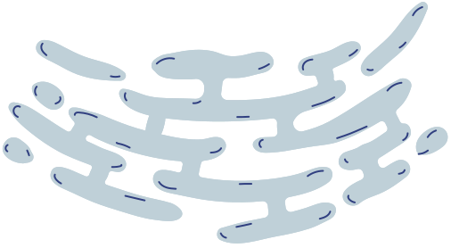
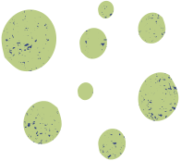

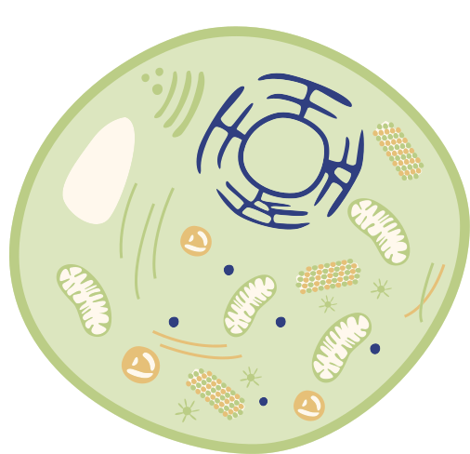
Metabolism
Morphological Characteristics
Spirochaetes can be anaerobic, facultatively anaerobic, or aerobic.
They utilize various carbon and energy sources, including carbohydrates, amino acids, long-chain fatty acids, and long-chain fatty alcohols.
They are slender, long bacteria (ranging from 0.1 to 3.0 μm by 5 to 250 μm) with a flexible, helical shape.
The central protoplasmic cylinder contains cytoplasm and the nucleoid, surrounded by a plasma membrane and a gram-negative cell wall.
Two or more than a hundred flagella (axial fibrils or periplasmic flagella) extend from both ends of the cylinder, often overlapping in the middle.

Slide 4

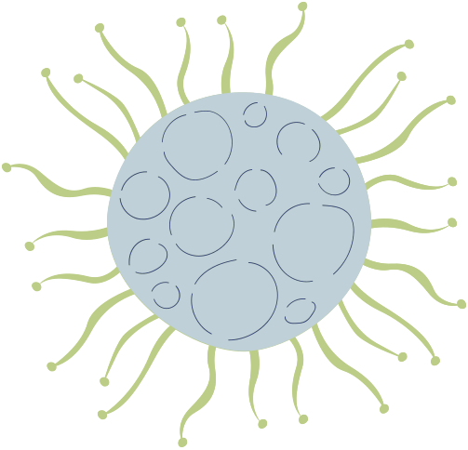
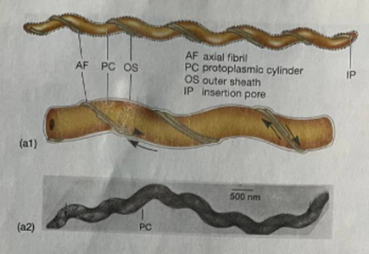
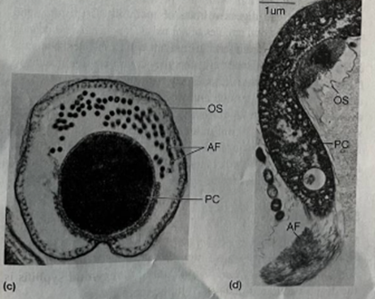
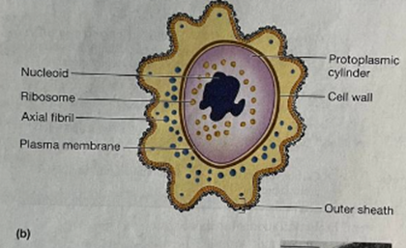
Axial Filament and Outer Sheath
The axial filament, composed of periplasmic flagella, is located inside a flexible outer sheath made of lipid, protein, and carbohydrate.
The precise function of the outer sheath is unknown, but it is crucial for the survival of spirochaetes; they die if the sheath is damaged or removed.
The outer sheath of Treponema pallidum (the syphilis spirochaete) has few surface proteins, allowing it to evade host antibodies.

Slide 5
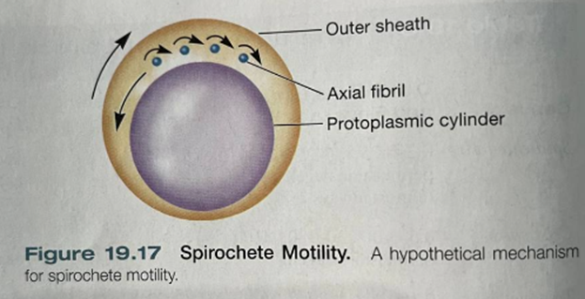
Unique Motility
Spirochaetes have a distinct mode of movement adapted for viscous environments.
The rotation of axial fibrils causes the outer sheath to rotate in the opposite direction, enabling a corkscrew-like movement through liquids.
This motility also allows for flexing and crawling on solid surfaces.
Ecological Diversity
Spirochaetes are ecologically diverse, inhabiting various environments from mud to the human mouth.
Genera such as Spirochaeta are free-living and typically grow in anaerobic muds.

Slide 6
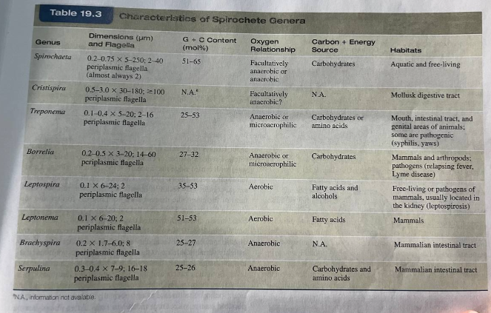

Characteristics of Spirochete Genera

Slide 7

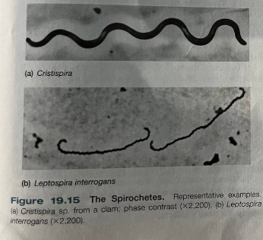
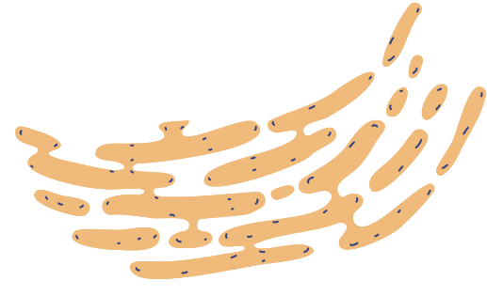
The Spirochetes
Cristispira sp.:
Marine spirochete found in mollusks (e.g., clams).
Large, helical shape.
Likely involved in mollusk digestion.
Leptospira interrogans:
Causes leptospirosis (zoonotic disease).
Transmitted via contaminated water/soil.
Thin, flexible spiral shape.

Slide 8
Nitrogen Fixation
Pathogenic
Spirochaetes
Some spirochetes can fix nitrogen, particularly in termite hindguts and freshwater sediments, contributing to the nitrogen nutrition of termites.
Several species are human pathogens, including Treponema pallidum (causative agent of syphilis) and the spirochetes responsible for Lyme disease.
Symbiotic Associations
Spirochetes often form symbiotic relationships with other organisms. For example, spirochetes help move the flagellate Myxotricha paradoxa.

Slide 9
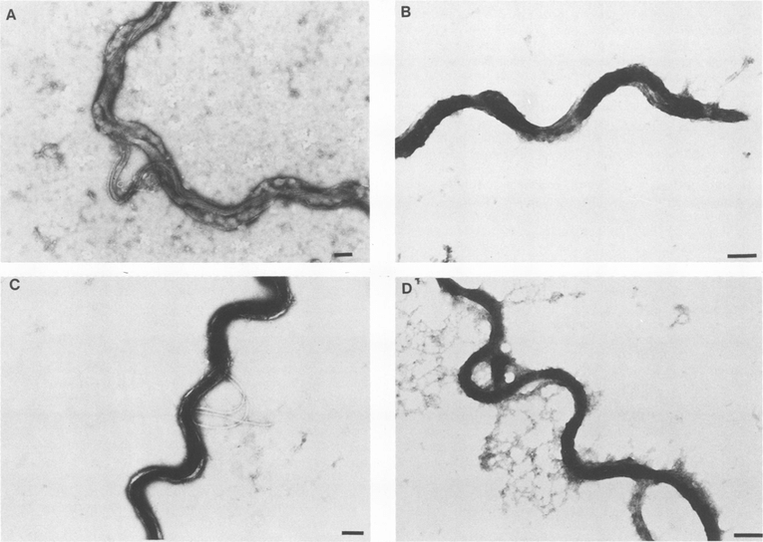
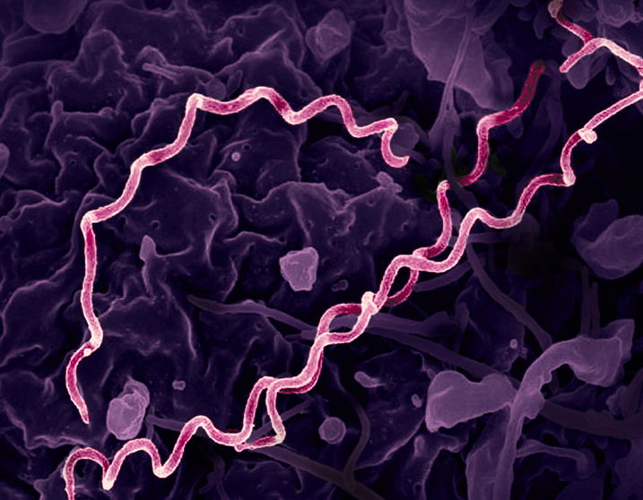
Syphilis
Syphilis is a sexually transmitted disease caused by the bacterium Treponema pallidum subsp. pallidum (T. pallidum).
It enters the body through mucous membranes or minor skin abrasions.
The disease is not highly contagious, with only about a 1 in 10 chance of transmission from a single exposure to an infected partner.
Congenital syphilis occurs when the disease is transmitted from mother to fetus.

Slide 10
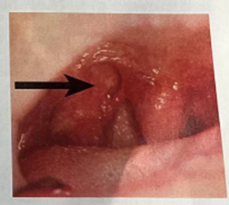
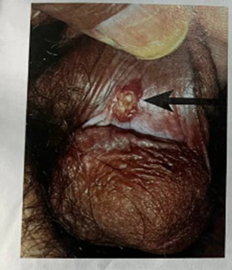
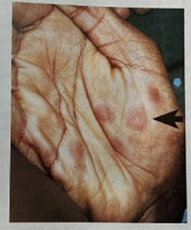
b. Palmar lesions of secondary syphilis
c. Ruptured gumma and ulcer of the upper hard palate of the mouth
a. primary syphilitic chancre of the penis

Slide 11
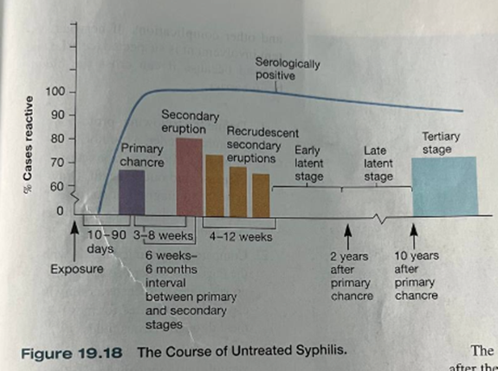
Stages of Syphilis
Primary Stage:
After an incubation period of 10 days to 3 weeks, a painless ulcer (chancre) forms at the infection site. It may heal on its own, but T. pallidum can enter the bloodstream and spread.
Secondary Stage:
A variable skin rash appears within 2 to 10 weeks of the primary lesion, along with symptoms like hair loss, malaise, and fever. Both the rash and chancre are infectious.
Latent Stage:
The disease becomes dormant and is typically not infectious, except for potential transmission from mother to fetus.
Tertiary Stage:
Occurs in 40% of untreated individuals, marked by degenerative lesions (gummas) in skin, bone, and the nervous system. Central nervous system involvement can lead to cognitive deficits, blindness, or insanity.

Slide 12
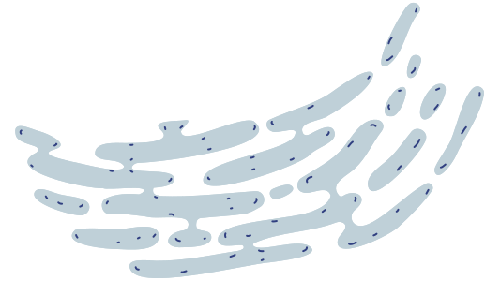

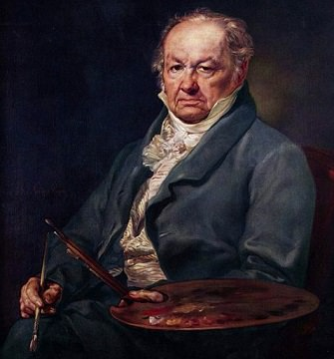


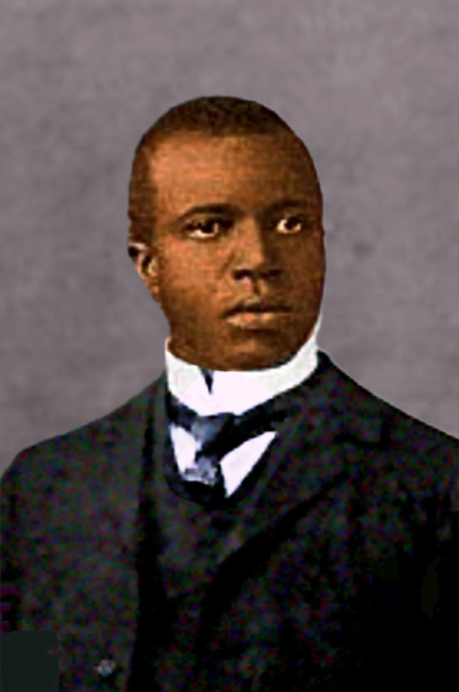

Famous Cases
Historical figures like Al Capone, Francisco Goya, Henry VIII, Adolf Hitler, Scott Joplin, Friedrich Nietzsche, and Oscar Wilde are believed to have suffered from syphilis.

Slide 13
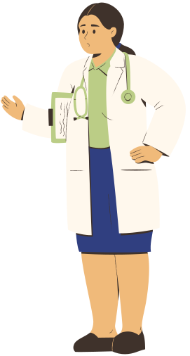
Treatment
Epidemiology
Early stages of syphilis can be treated effectively with penicillin.
Later stages, especially neurosyphilis, are harder to treat and may require larger doses of antibiotics.
Immunity to syphilis is not complete, and reinfection is possible.
Approximately 12 million new cases of syphilis occur worldwide each year.
In the U.S., there are fewer than 10,000 cases of primary and secondary syphilis and about 500 cases of congenital syphilis annually.
The highest incidence occurs among people aged 20 to 39 years.
Syphilis incidence has risen in HIV-positive individuals, and co-infection with advanced syphilis increases susceptibility to HIV.

Slide 14
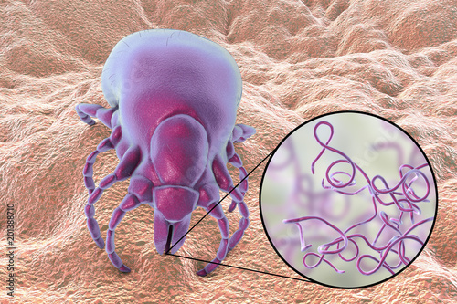
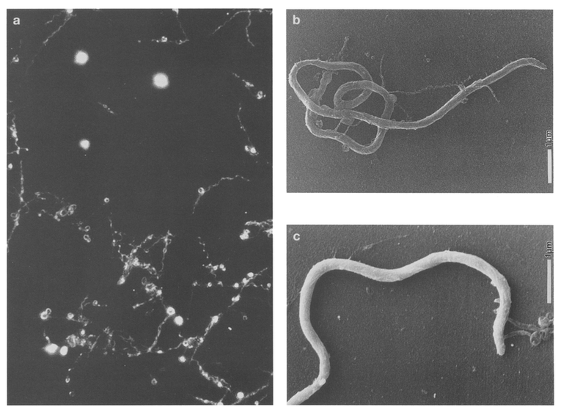
Lyme Disease
Lyme disease, also known as Lyme borreliosis, is caused by Borrelia spirochetes, primarily Borrelia burgdorferi, B. garinii, and B. afzelii.
It is the most common tick-borne disease in the United States, with about 17,000 cases reported annually. It is also found in Europe and Asia.
Deer and field mice are the natural hosts, and in the U.S., Lyme disease is transmitted to humans by the bite of infected deer ticks (Ixodes scapularis). On the Pacific Coast, the woodrat and tick I. pacificus serve as reservoirs.

Slide 15
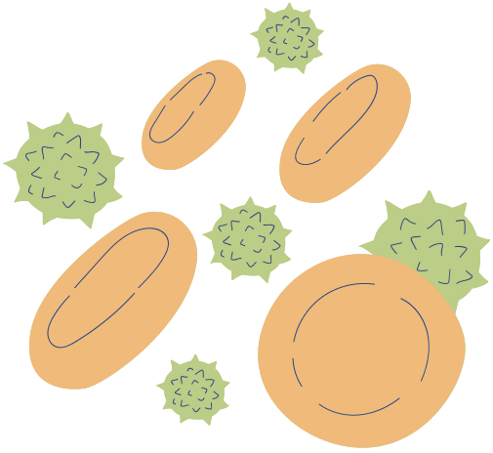
Stages of Lyme Disease
Stage 1 (Localized): Occurs 1-2 weeks after a tick bite. Symptoms include an expanding ring-shaped rash called erythema migrans and flu-like symptoms (fatigue, headache, fever, and chills). Tick bites often go unnoticed, and the rash may be missed due to skin coloration or location.
Stage 2 (Disseminated): Weeks or months later, symptoms may include neurological abnormalities, heart inflammation, and bouts of arthritis in major joints like the elbows or knees. These symptoms are triggered by the immune response to spirochetal proteins.
Stage 3 (Late): Years after infection, individuals may develop neuron demyelination, with symptoms similar to Alzheimer's disease and multiple sclerosis.

Slide 16
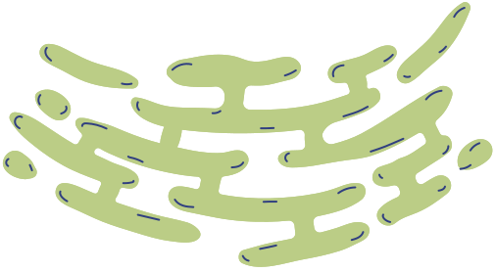
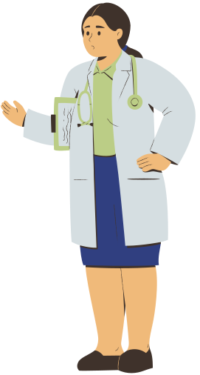
Prevention
Treatment
Early treatment with amoxicillin or tetracycline is effective and can prevent complications like arthritis.
If nervous system involvement is suspected, penicillin is used because it can cross the blood-brain barrier.
1.Remove Ticks Promptly: Ticks need at least 24 hours to transmit bacteria. Use tweezers to pull the tick out slowly.
2.High-Risk Period: Peak risk is from May to July when deer tick nymphs are most active.
3.Protective Clothing: Wear light-colored clothes, tuck pants into socks, and check for ticks after being in wooded areas.
4.Use Repellents: DEET or permethrin repellents are effective. Permethrin is only for clothes.
5.Body Checks: Check your body after exposure, focusing on hard-to-see areas like the scalp, armpits, and groin.
Importance of Early Diagnosis
Early diagnosis and prompt treatment are crucial to avoid the progression of Lyme disease and the development of severe, long-term complications.

Slide 17
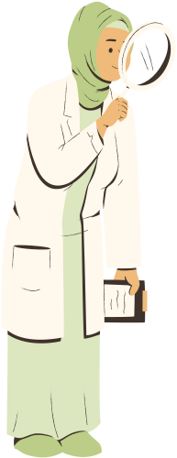
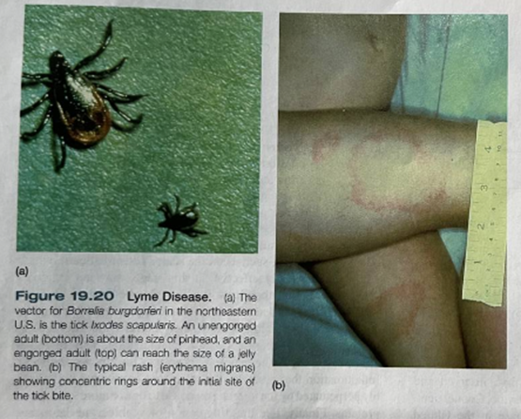

Slide 18
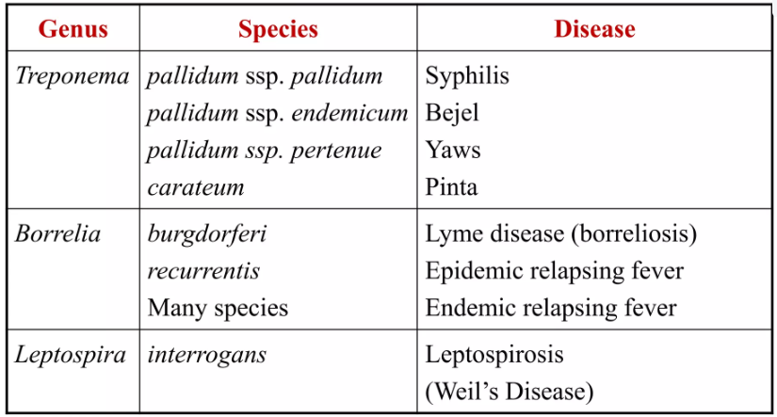
ASSOCIATED WITH HUMAN DISEASE

Slide 19
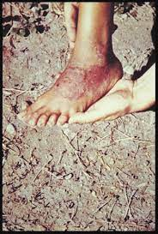
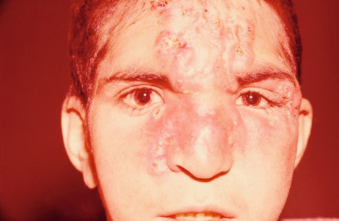
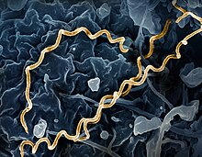
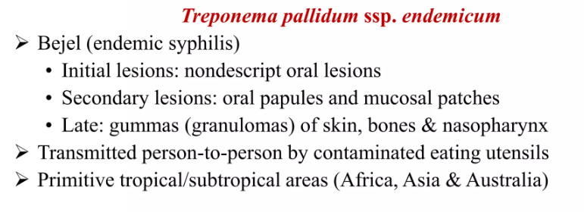

Slide 20
Primary Symptoms
Painless sores (ulcers) in the mouth, lips, or on the skin, especially around the mouth area.
The initial lesions might heal without treatment but signal the onset of infection.
Secondary Symptoms (appear weeks to months later)
Rashes: Small, non-itchy rashes, often on the limbs, face, or trunk.
Wart-like growths: Small, raised lesions called condylomata lata can appear on moist skin areas like the armpits or groin.
Swollen lymph nodes: Particularly around the sites of infection.
Tertiary Symptoms (in untreated cases over years)
Bone and joint pain: Due to bone lesions or chronic inflammation.
Disfigurement: Severe cases may develop deformities in the nose and bones.

Slide 21
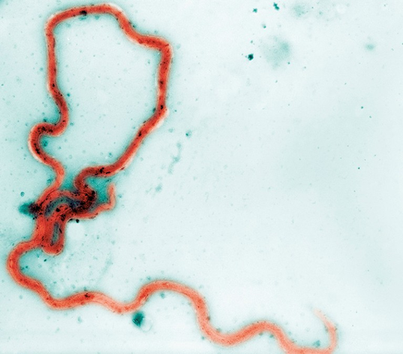
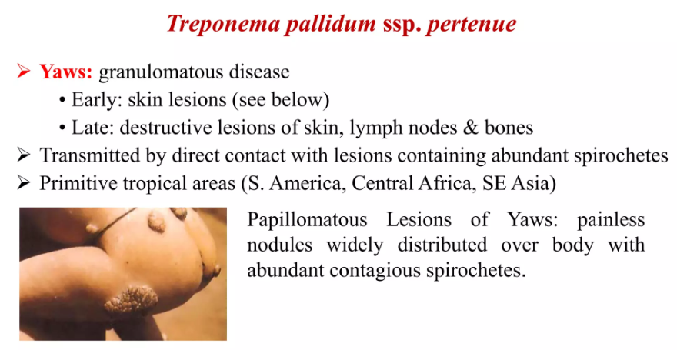

Slide 22
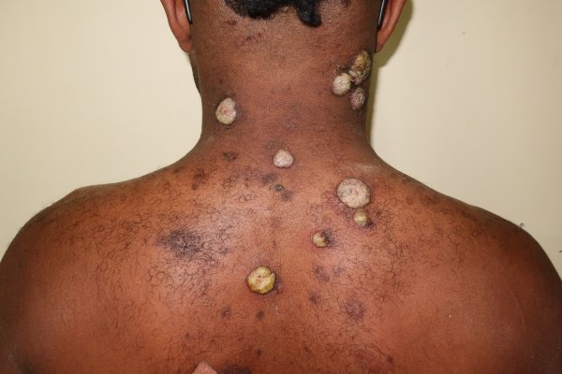
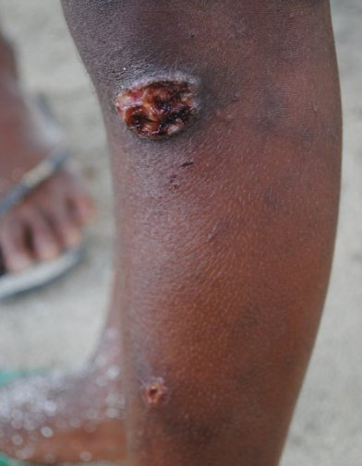
YAWS

Slide 23
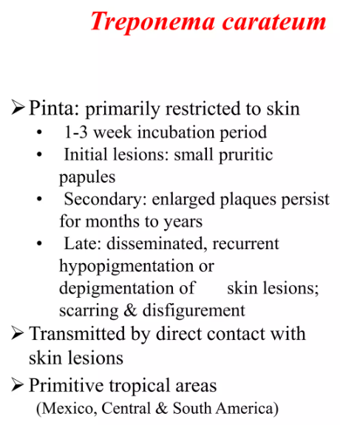
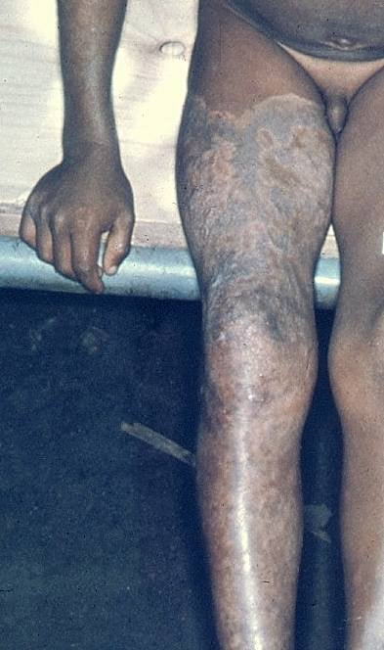

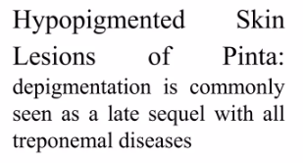

Slide 24
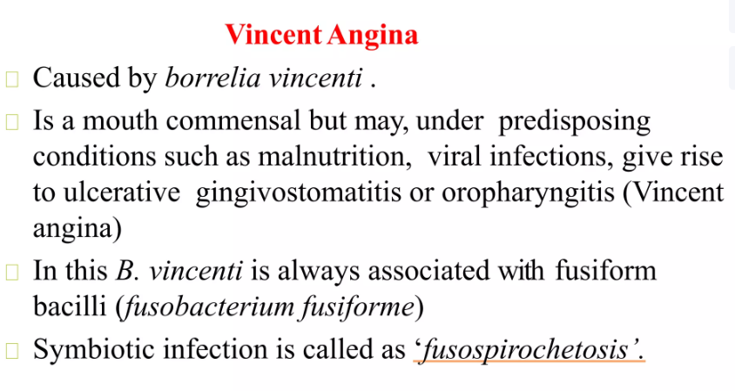
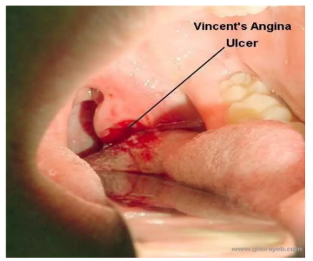
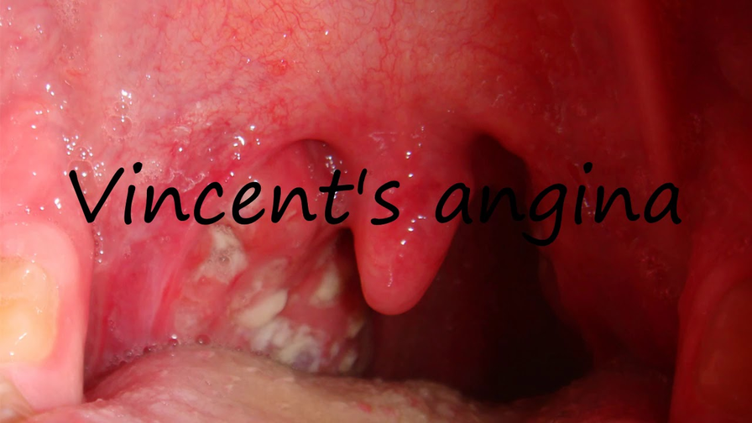
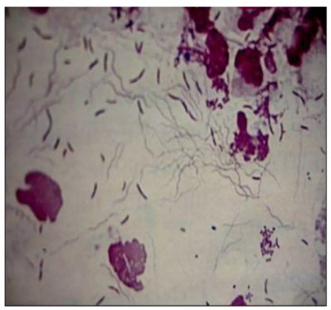

Slide 25
SYMPTOMS:
Intense Gum Pain: Severe pain in the gums, which may intensify while eating or drinking.
Ulceration and Necrosis: Ulcers form along the gum line, often with dead tissue and bleeding.
Grayish Membrane on Gums: A gray or yellowish-white film can form over the ulcers, which can be peeled off to reveal bleeding tissue.
Foul Breath: Due to bacterial overgrowth and tissue decay, there is often a strong, unpleasant odor.
Swelling and Redness: The gums become swollen, red, and bleed easily, with tissue degeneration in advanced cases.
Fever and Malaise: Some patients may experience fever, fatigue, and swollen lymph nodes.

Slide 26
THE END

Slide 27
B for blur
C for confetti
Press
these keys
while on Present mode!
D for a drumroll
M for mic drop
O for bubbles
Q for quiet
Any number from 0-9 for a timer
U for unveil

